Slide 1
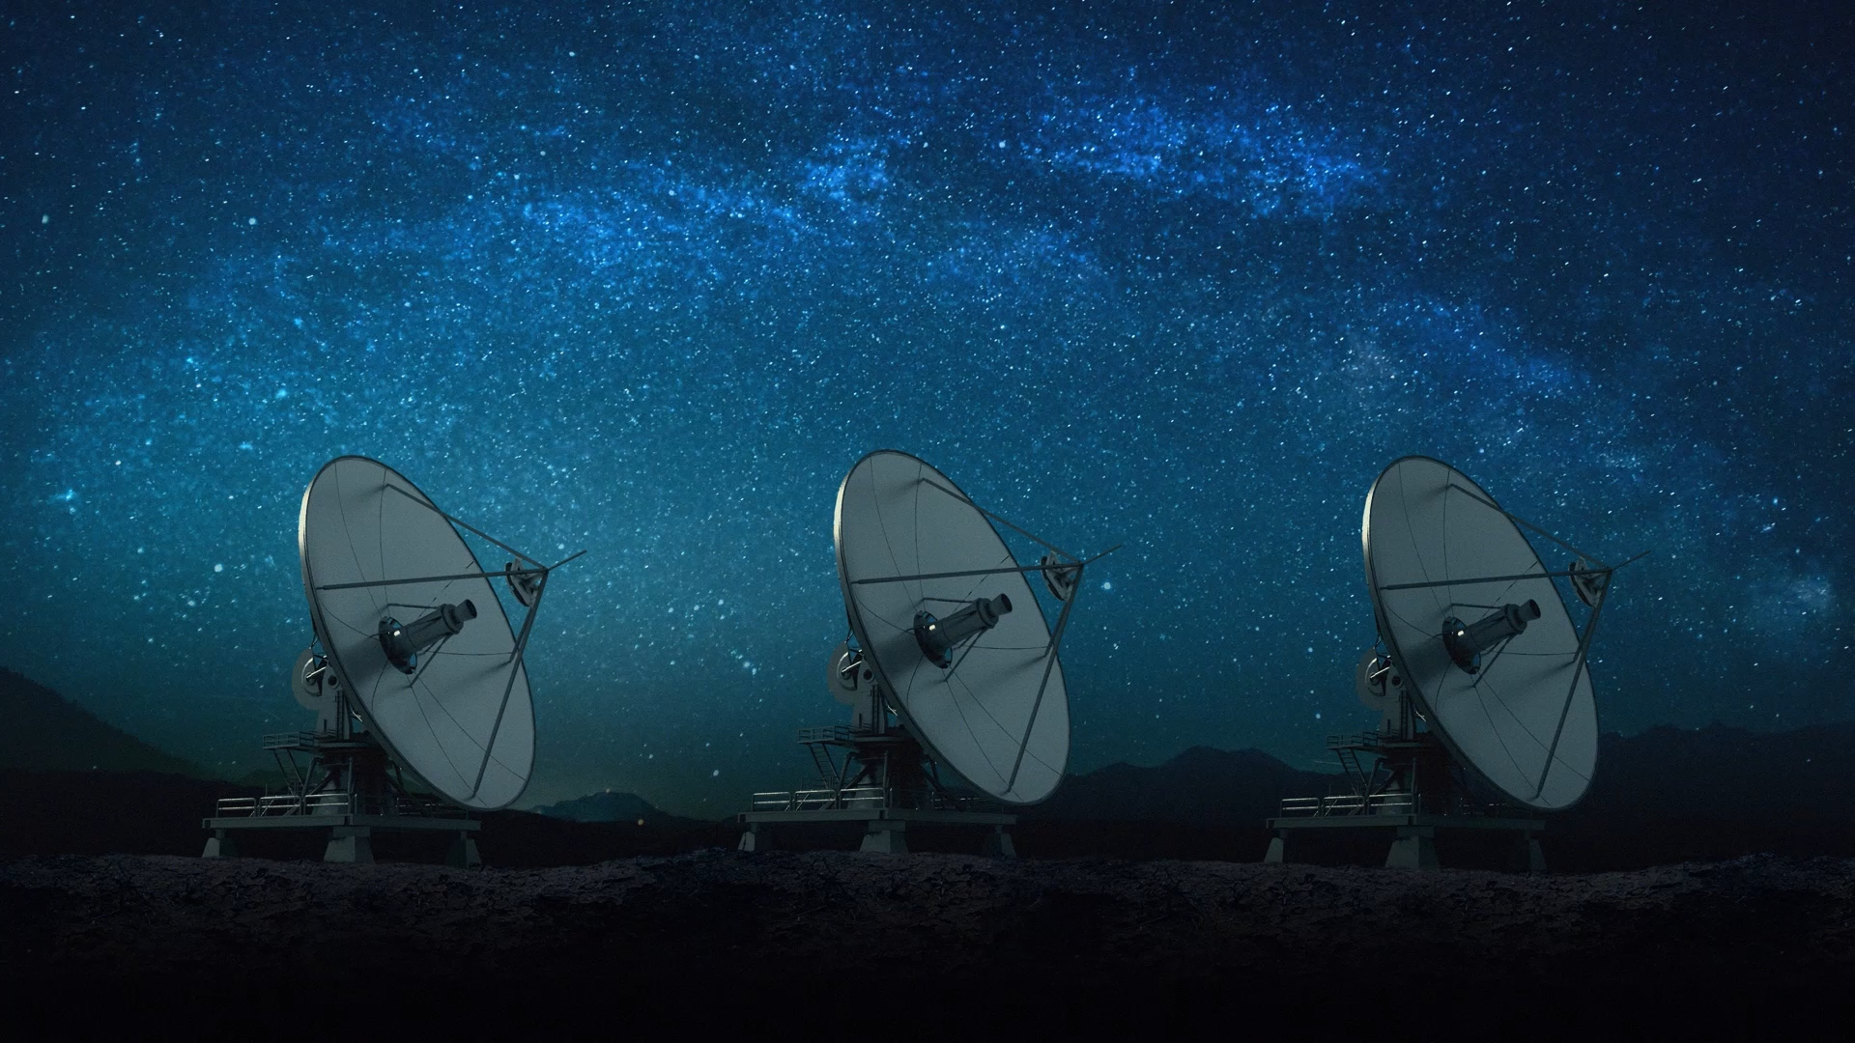
Electromagnetic Spectrum Usage by Satellites
Tashi Hatchell (Alexander)
DDI-12

Slide 2
Research Question/Objective
Objective:
Analyze how different satellite missions use the electromagnetic spectrum – highlighting which frequency bands are most common and which mission types are most dependent on specific bands.
Background
Working in an EW Delta
How it Addresses a Specific Problem or Question

Slide 3
Background Information
Electromagnetic Spectrum
Frequency Bands
Frequency Band Proxy Mapping
Frequency Band Proxy Mapping
Mission Purpose | Typical Frequency Band
Communications | C, Ku, Ka
Earth Observation | X, S
Navigation/GNSS | L
Weather Monitoring | S, X

Slide 4
Data Sources & Transformations
Where Data Comes From, Reliability, Limitations
Summarize Cleaning and Transformation Steps in Non-Technical Way

Slide 5
Contextual Visualizations
Bar Chart (Satellite Missions by Frequency Band)
X = Mission Purpose
Y = Number of Satellites
Satellites By Country in Each Orbit

Slide 6
Stacked Bar Chart (Comparing Mission Types Across Multiple Bands)
X = Mission Purpose
Stacked = Frequency Bands
Heatmap (Correlations Between Mission Type and Orbit Type)
Rows: Mission Purpose
Columns: Orbit Type
Color Intensity: Number of Satellites

Slide 7
Key Insights & Recommendations
Vulnerabilities

Slide 8
Future Areas of Research
Bands that are susceptible to space weather/solar activity

Slide 9
Contact Info

